Slide 1

TAMU Swarm manufacturing meeting
Rencheng
Feb 04, 11

Slide 2
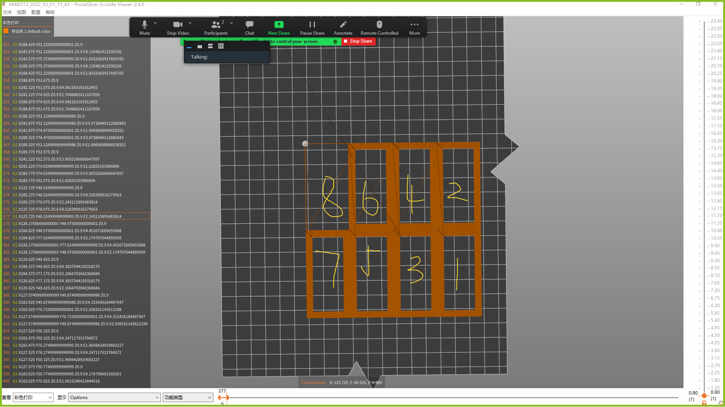
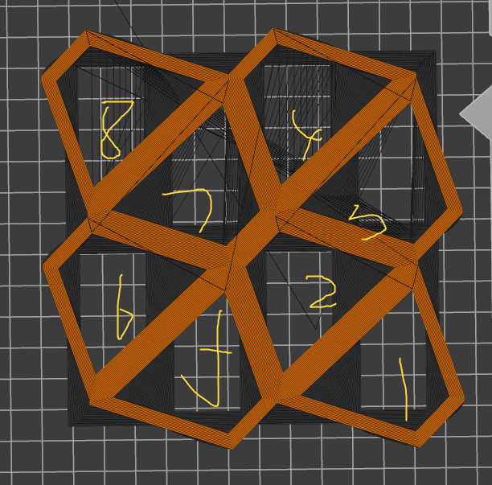
TAMU Swarm manufacturing project
Problem 1:
Printing sequence changes after the cells shifting at No.13 and No.39 layer.
Starting sequence: Start the second printer after the first printer prints 4 cells.
The printers collide after the sequence changes at No.13 layer.
Potential solution: Add wait command in G-code to adjust sequence at No.13 and No.39 layer.

Slide 3
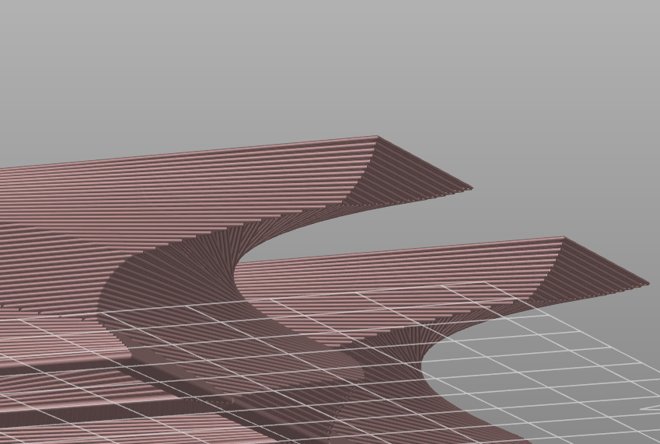
TAMU Swarm manufacturing project
Problem 2:
For the cells shifting on the border on each layer, it start to print from the outmost loop instead of inside out, so the new loop would not have any support or connection with pervious layers.
Printing sequence: Start from the outmost loop to the inside.
The boundary structure collapse.

Slide 4
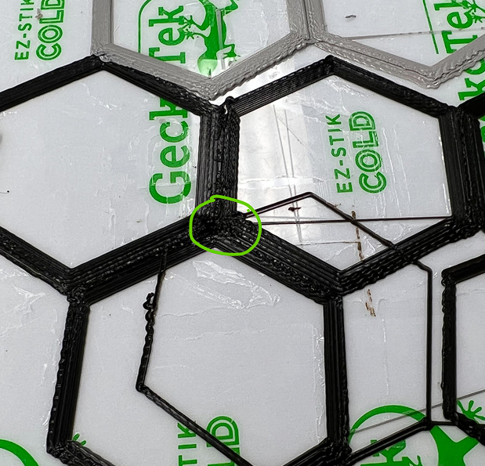
TAMU Swarm manufacturing project
Problem 3:
The error of each layer’s overlapping adds up will randomly cause the nozzle collide to the printing product.
Only solution now(Laxmi):
Pause it when this happen.
HOME the nozzle again.
Clean the collide position.
Continue the printing.

